Slide 1

Library system
G6 TEAM

Slide 2



About us
G6 team has united at Feb of 2020
Team members
Sarankhuu, Gantushig, Vo, Tamir.

Slide 3
System Features CRUD /create, read update delete/
User authentication /Login/
Member management
Book management with book add /ADDITIONAL/
Overdue book report /ADDITIONAL/
Author management
Checkout /ADDITIONAL/

Slide 4
Team work
Implementation
Class diagram
Sequence diagram
Use case diagrams
Coding

Slide 5
USE CASE DIAGRAMS

Slide 6

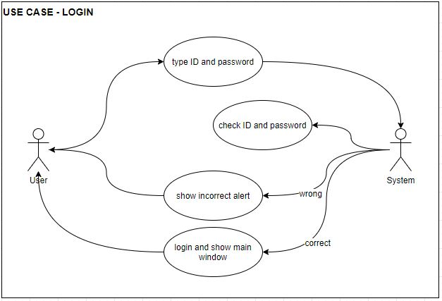

Slide 7
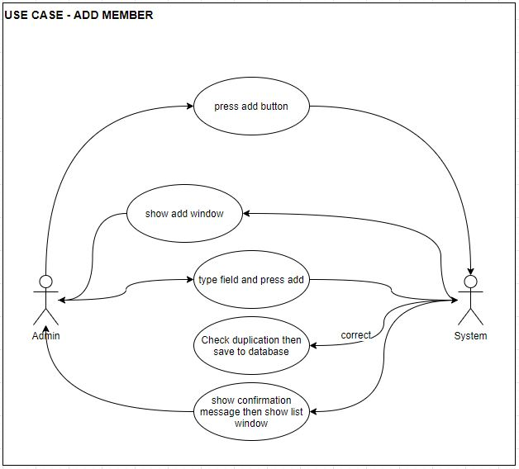

Slide 8
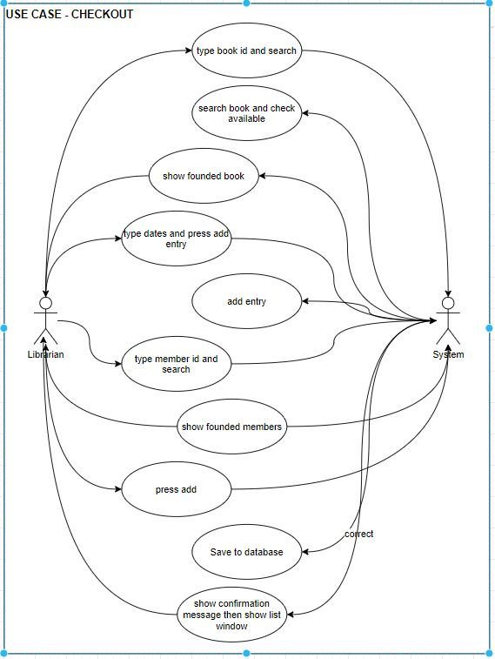

Slide 9
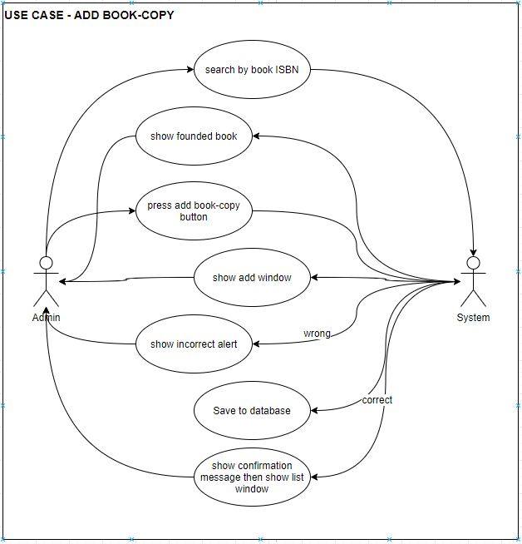

Slide 10
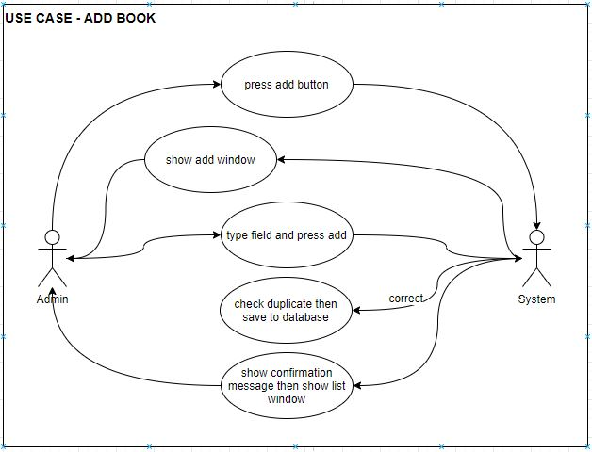

Slide 11
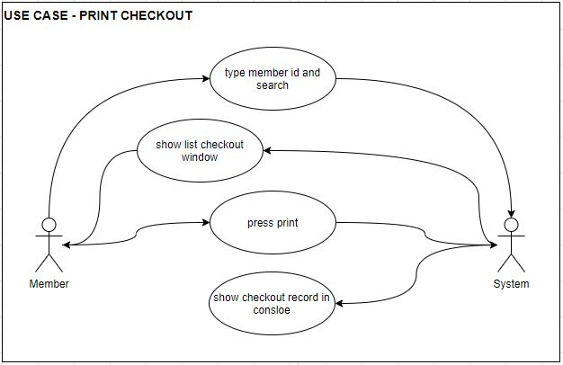

Slide 12
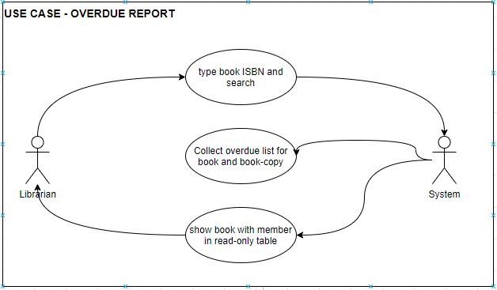

Slide 13
CLASS DIAGRAM

Slide 14
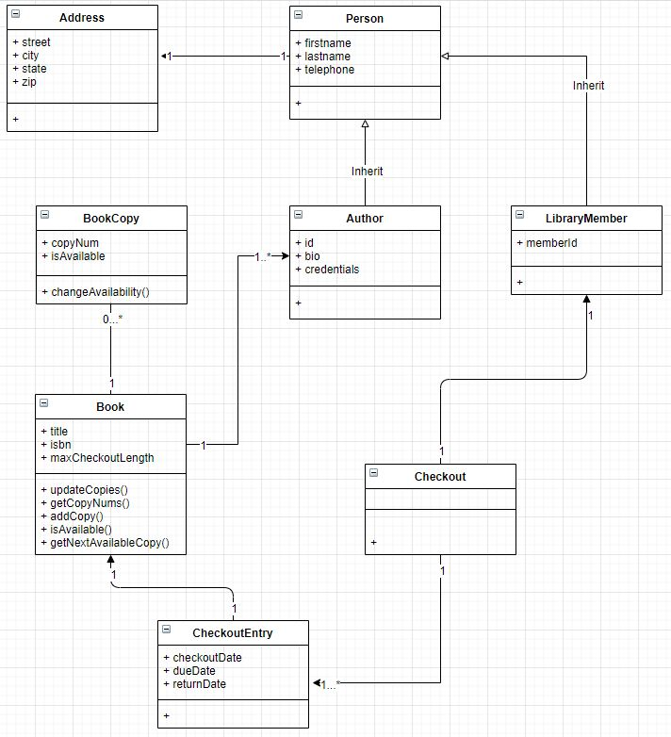
Collect all nouns and clear it. Create domain class.
Address class. We have created a separate class for two reasons. First, Address fields are the same for both library members and authors, so we anticipate reuse by factoring out an Address class. Second, Address has own fields which are street, City, State and zip.
Depends on requirement create implementation class. We add id for all association classes. Which is needed for easy to access and find.

Slide 15
SEQUENCE DIAGRAMS

Slide 16
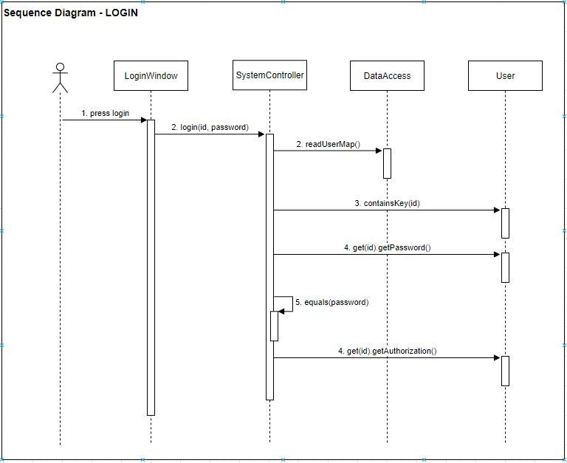

Slide 17
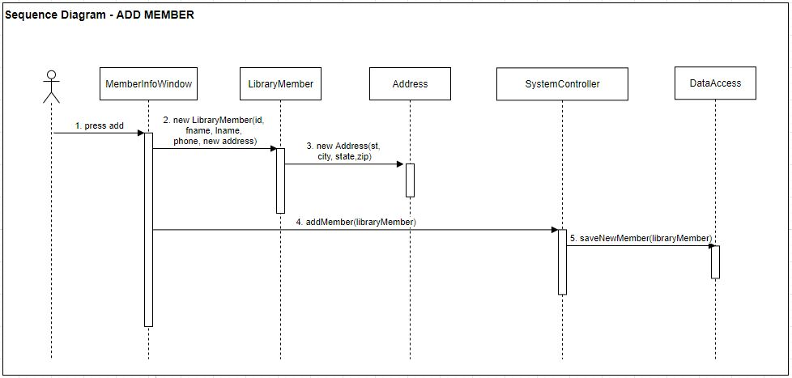

Slide 18
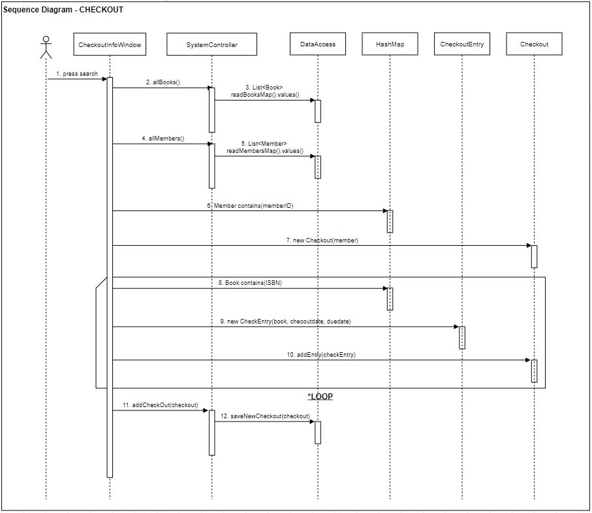

Slide 19
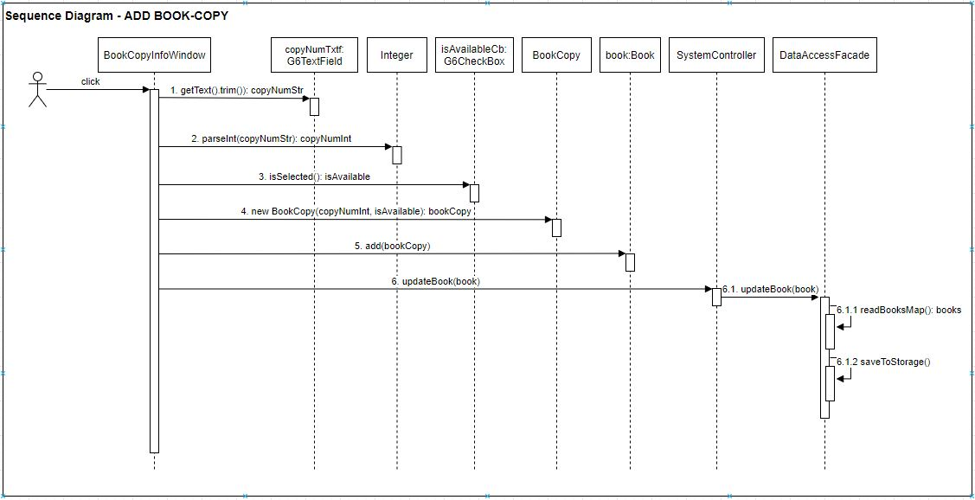

Slide 20
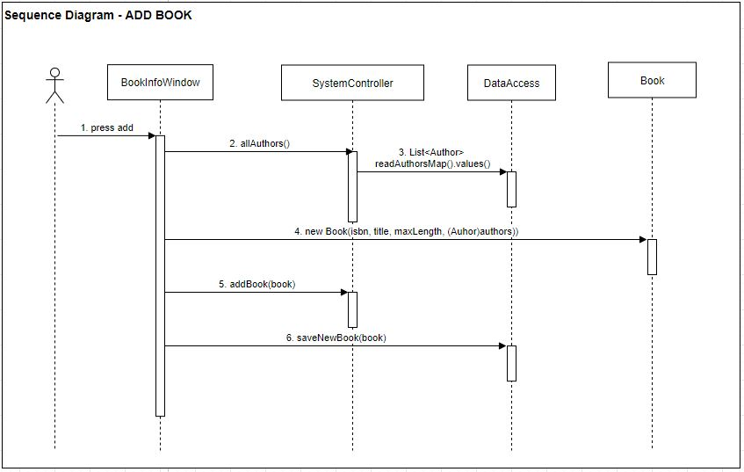

Slide 21
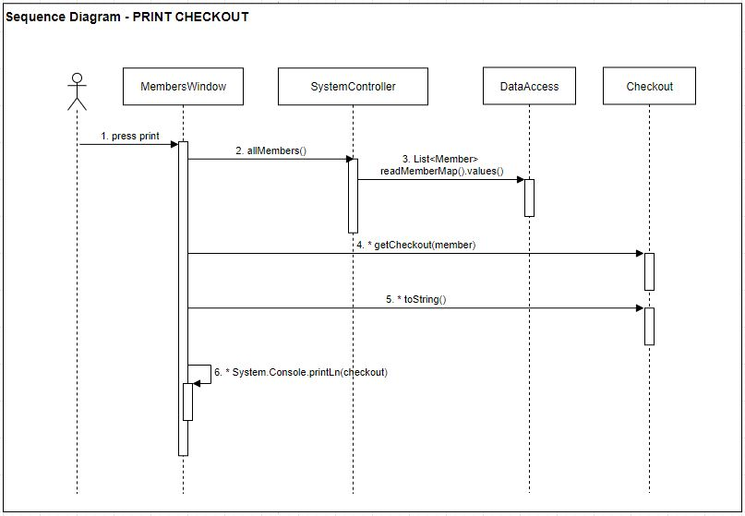

Slide 22
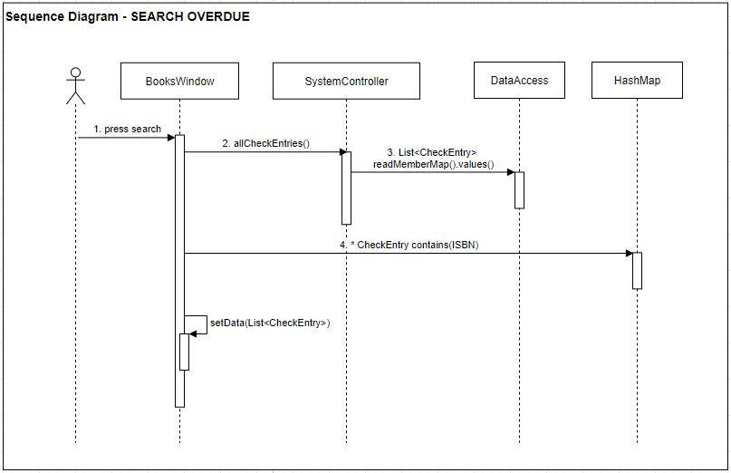

Slide 23
DEMO
LIBRARY SYSTEM

Slide 24

TEAM management
No | Tasks and desicion | Start | Stackholder
1 | Collect all nounce and clear it. Create domain class. | 3/4/2020 | All
2 | Address class. We have created a separate class for two reasons. First, Address fields are the same for both library members and authors, so we anticipate reuse by factoring out an Address class. Second, Address has own fields which are street, City, State and zip. | 3/4/2020 | All
3 | Depends on requirenment create implementation class. We add id for all association classes. Which is needed for easy to access and find. | 3/4/2020 | All
4 | Drawing class diagram | 3/4/2020 | Saraa
5 | Working on UI class diagram. Create register, list and message Stage as a template and implement from them for all other scenes. | 3/4/2020
6 | Configuring and testing our TEAM environment on GitHub | 3/4/2020 | Tushig and Vo
7 | Determine all Stage which we create. And draw actual as basic. Login, CRUDS /create, read, update, delete, search/ concepts on Member, Book, Book-copy, Member, Author and CR concepts on Checkout, Overdue. | 3/5/2020 | Vo
8 | Draw Sequence diagram.Checkout and Add Member. For control mentioned those as a Class name. That means all UI actions are not mentioned in sequence diagram. | 3/5/2020 | Saraa and Tamir
9 | UI super classes for components. Will needed for easy change appearance, same design and same locations of controls. | 3/5/2020 | Tushig
10 | Book implementation | 3/5/2020 | Saraa
11 | Member implemenataion | 3/5/2020 | Tushig
12 | Author implementation | 3/5/2020 | Vo
13 | Book-copy implementation | 3/6/2020
14 | Checkout implemenataion | 3/6/2020 | Tamir
15 | Overdue implementation | 3/6/2020

Slide 25

Thank You!
All connected to UNIFIED FIELD

